Slide 1
The Currency of The U.A.E.
is...

Slide 2
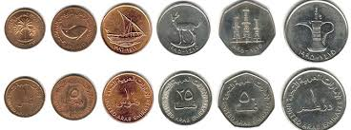
United Arab Emirates Dirham (Dhs. or AED)
A U.A.E Dirham can be divided up into…
How many fils?
100

Slide 3
Let's take a closer look.
Do you know the value of these coins?
Can You Identify what pictures are on these coins?

Slide 4
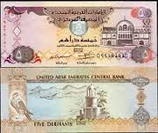
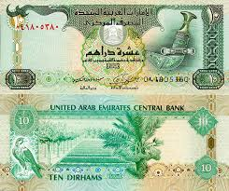
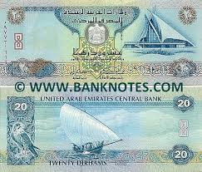
What about the banknotes?
What pictures can you see on the banknotes?
Are these bits of paper more valuable than the coins?

Slide 5
How many combinations of notes and coins can we use to get the 57 Dhs needed to buy...

