Slide 1
The pearl
The Jewel of Dubai

Slide 2
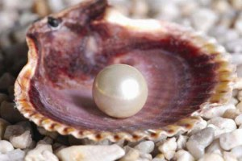
One of the earliest industries from the Emirates started from the sea.
The pearl or Qamashah industry was internationally recognized and many companies from around the world wanted pearls from the Emirates.
The pearling industry started well before the discovery of oil.

Slide 3
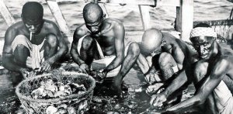
It is not clear exactly when the pearling industry started in this region but pearls have been discovered by archeologists dating back to well over 7000 years ago!

Slide 4
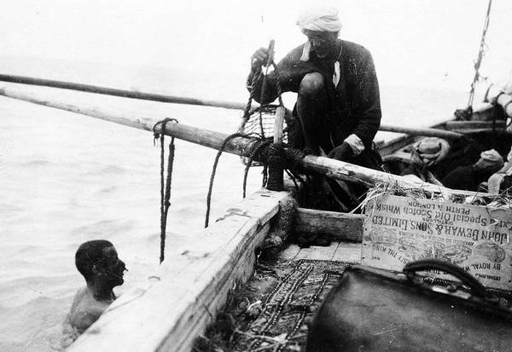
In the early 20th century, 69% of the population of Dubai was involved in the pearling industry!

Slide 5
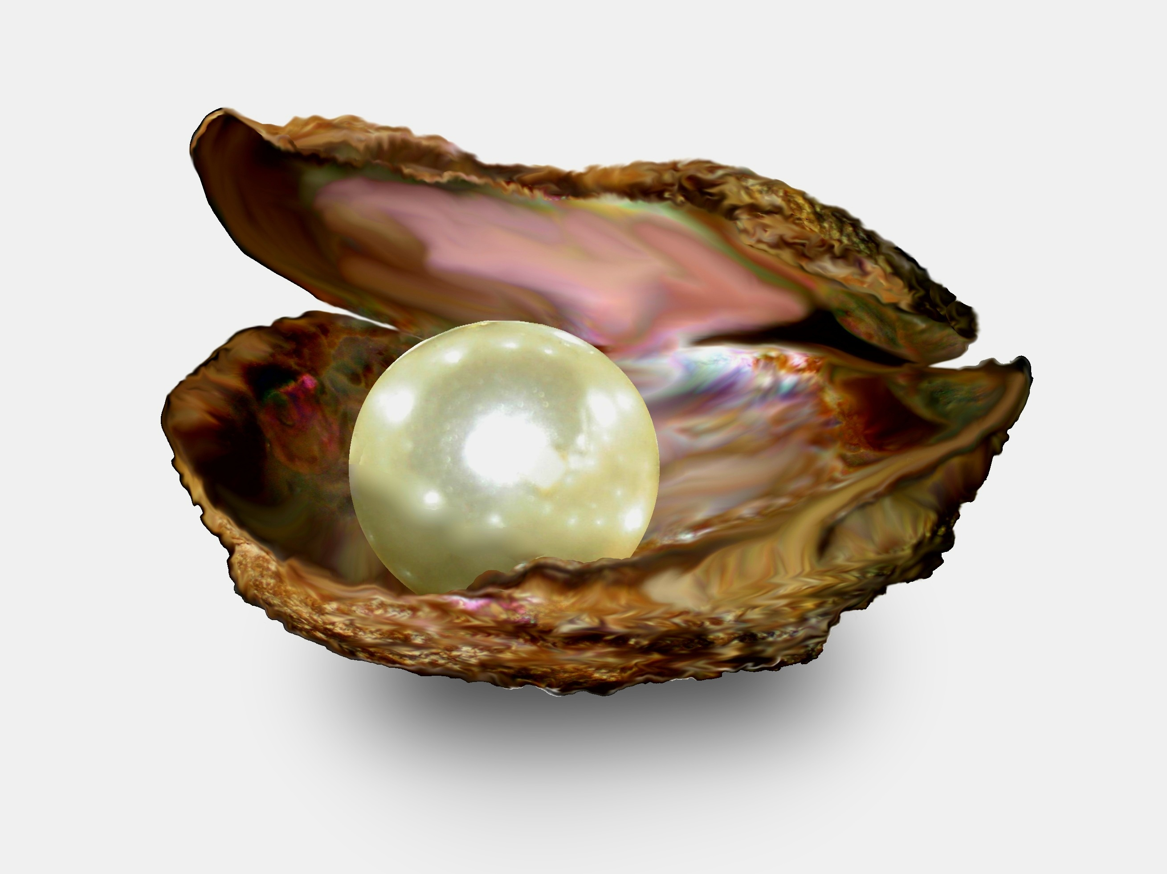
What do you think life was like for pearl divers?

Slide 6
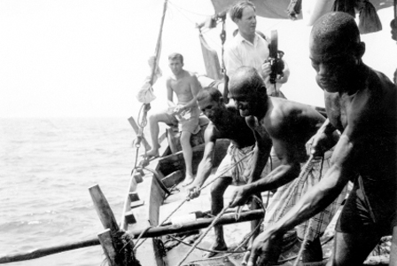
Although the pearling industry offered potential wealth, it was also very dangerous for the divers, both physically and financially.

Slide 7
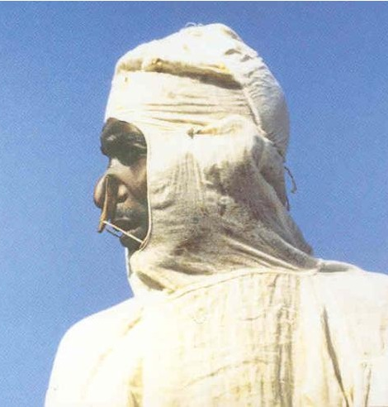
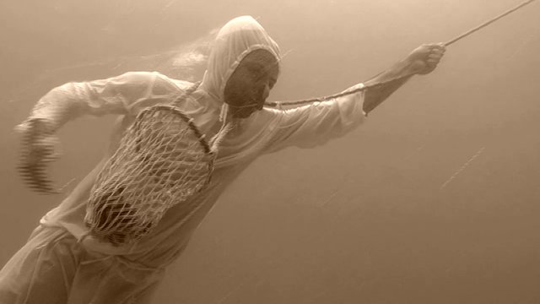
Pearl divers worked from sunrise to sunset, wearing only a nose clip, leather finger protectors, a stone weight and occasionally a cotton suit to protect them from jellyfish.

Slide 8
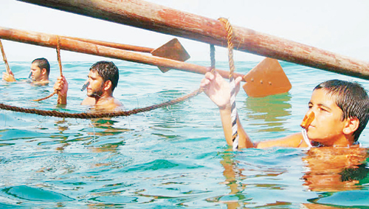
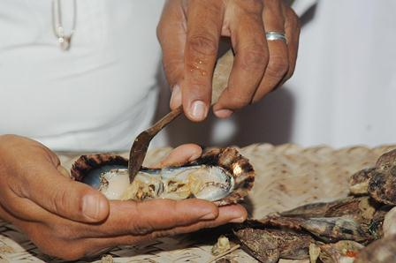
They would dive for 90 seconds, around 40 meters deep, and they would descend about 30 times in one day, and collect about 12 shells in each dive.

Slide 9
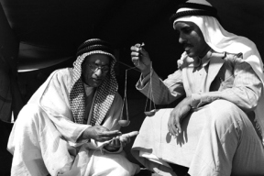
Once back on the vessel they begin to open the oysters with the “Meflaga”, a curved knife specially designed to open and search for the pearl.
If a pearl were found it was given to the captain, who would keep it and negotiate with the merchant, waiting at the banks on dhows, and the diver would get a small share.

Slide 10
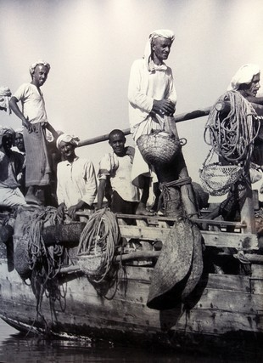
They would be at sea from mid-May to early September.
Men were inducted into the pearling business at age 9 - when they had to pry open oyster shells with knives to get to the pearl. Age 12 onwards, they began to dive.
Around 50, it was time to stop.

Slide 11
Key Stage 1 Extension Activities
a) Discuss what life was like on board a pearl diving dhow. Would you have worked on a dhow like this?
b) Draw a picture which shows the process of pearl diving from start to finish and label it.
Key words – dhow, nose clip, rope, pearl, jellyfish, trade, profit, season…)

Slide 12
Key Stage 2 Extension Activities
Discuss what life would have been like for a 10 year old boy on board a pearl diving dhow.
You are a 10 year old boy on board a dhow for your first pearl diving season. Write a short letter home describing your typical day on board.
Draw a picture showing the process of gathering pearls from the Gulf waters. Label important areas.

Slide 13
Vocabulary
Dhow nose clip net
Diver pearl rope
Shell season
Meflaga merchant

