Slide 1
The Mosque – No Mystery
Looking at Two famous mosques in then UAE

Slide 2
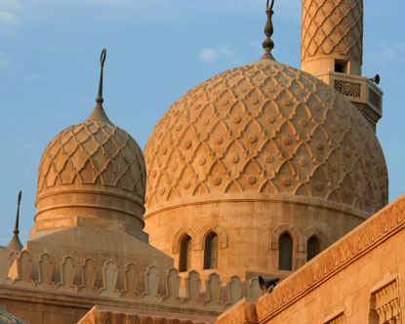
Jumeirah Mosque is one of the largest mosques in Dubai and one of the most photographed.
It includes both a modern and traditional design. The pattern on the domes is a traditional design named Fatimid – seen in many mosques.

Slide 3
Inside the mosque Muslims pray toward the Quibla wall inside Jumeirah Mosque Dubai. This wall always faces toward Mecca and is always the direction Muslims pray. The holiest location inside the mosque lies in the center of the prayer wall or Quibla and is called the Mihrab. This spot indicates which direction Mecca lies instructing the exact direction to pray toward. The third most important facet of Jumeirah Mosque Dubai is the Minbar. The Minbar sits on the right of the Mihrab. It is where the prayer leader, or imam, pronounces the holy Friday sermon. The Friday sermon touches on political, social and religious topics and is known as the khutba.
Qibla wall of Jumeirah Mosque, the wall, which faces Mecca, as this is the direction (Qibla), which a Muslim has to face while he is praying.
Mihrab, prayer niche in the center of the Qibla wall indicating the exact praying direction. It is also the `holiest’ place in the Jumeirah Mosque.
Minbar in Jumeirah Mosque , a platform to the right of the Mihrab from where the `imam’, the one who leads the prayer, delivers the `khutba’, the Friday sermon, which can deal with religious, social and political subjects.

Slide 4
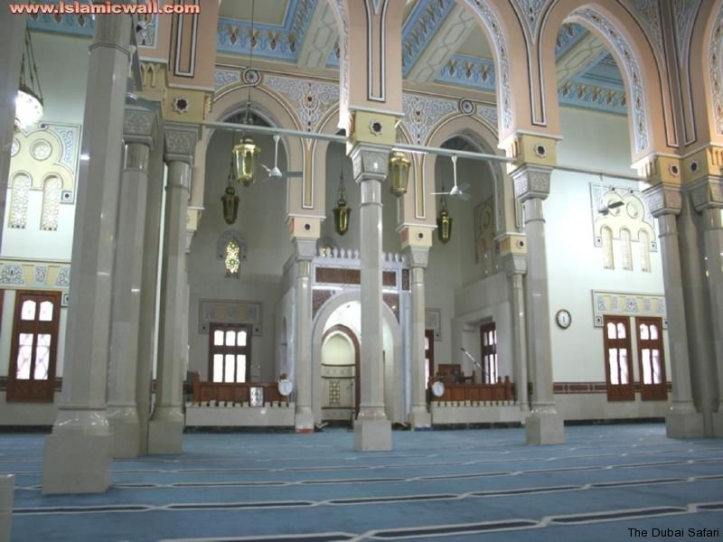
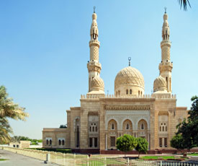
Jumeirah Mosque Dubai is the only city mosque that accepts non-Muslim visitors and only through organized Jumeirah Mosque tours. The only way for visitors to tour the mosque is to join one of the Jumeirah Mosque tours led by the Sheikh Mohammed Center for Cultural Understanding. The organization’s goals are directed at nurturing cultural awareness through direct experiences and promoting first-hand insight into Islam through their UAE tours.

Slide 5
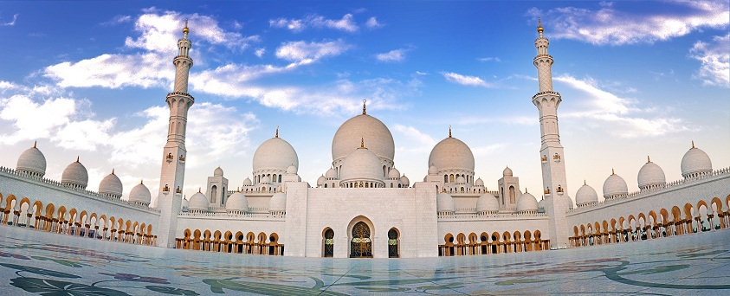
This architectural work of art is one the world’s largest mosques, with a capacity for an astonishing 40,000 people. It has 82 domes, over a 1,000 columns, 24 carat gold covered chandeliers and the world's largest hand knotted carpet.

Slide 6
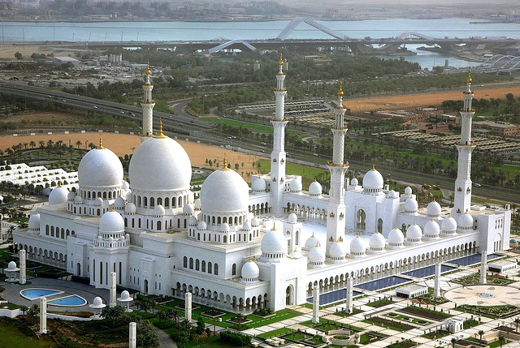
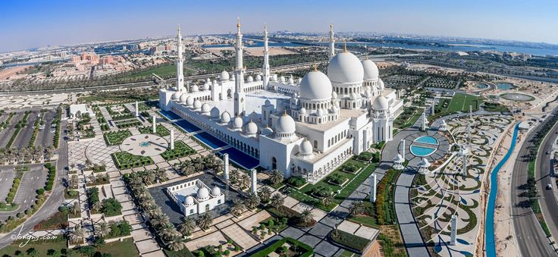
The mosque's first ceremony was the funeral of its namesake, Sheikh Zayed, who is buried at the site.

Slide 7
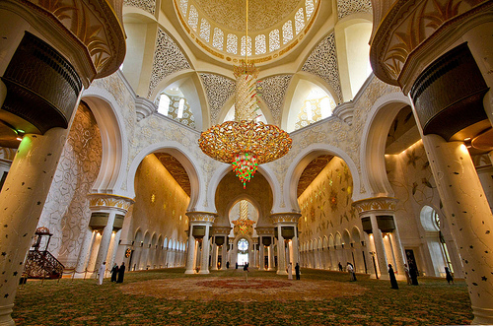
Sheikh Zayed Grand Mosque was a dream in the heart of the Late Sheikh Zayed bin Sultan Al-Nahyan "May God rest his Soul", where he established its general vision, set its foundation stone, and crowned thereby a journey full of fulfilled dreams and great achievements. The Mosque is an expression of a visionary leader who believed that nothing is impossible and conceived that the most gracious achievements start from the heart.

