Slide 1
Social studies
The story so far…

Slide 2
Let’s have a look at some of the topics we have studied and discussed so far in Social Studies.

Slide 3
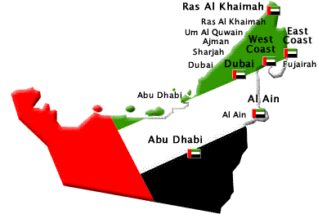
The Seven Emirates
We learnt the location and names of the seven Emirates of the UAE.
Can you remember them without looking at the map?
Test your partner.

Slide 4
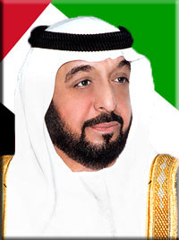
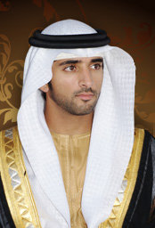
The Sheikhs of the UAE
We researched the leaders of each Emirate and the leaders of the country.
Sheikh Khalifa bin Zayed Al Nahyan
Sheikh Mohammed bin Rashid Al Maktoum
Sheikh Hamdan bin Mohammed Al Maktoum
President, Ruler of Abu Dhabi
Vice President, Prime Minister, Ruler of Dubai
Crown Prince of Dubai

Slide 5
Arabic Literature
We studied some examples of Nabati Poetry.
Nabati poetry has been a feature of life in Arabia since the 16th century.
This poetry is a type of story telling – an important part of Arab and Emirati culture.
In some areas it was the only record of historical events.
We learnt that Sheikh Mohammed is a great poet himself and he has declared 2016 as the year of reading. Have you read any Arabic stories yet?

Slide 6
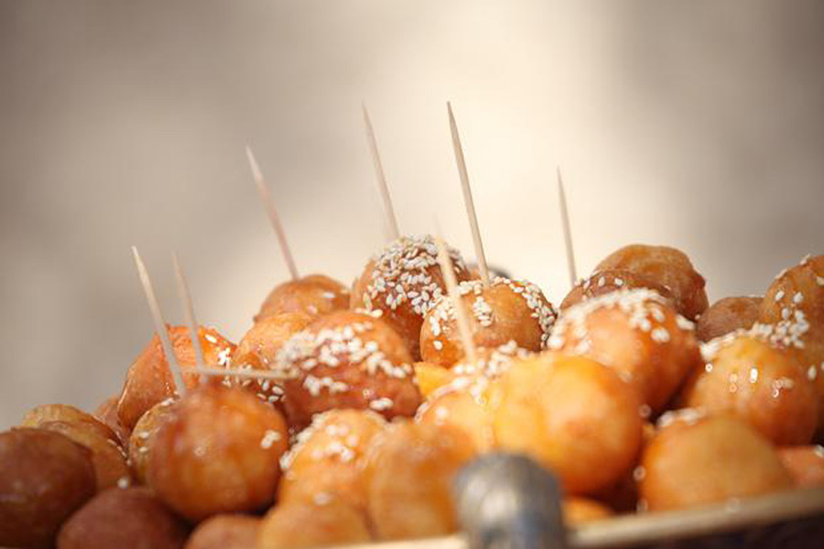
Traditional Arabic and Emirati Food
Do you remember the recipe or any of the ingredients for stuffed camel?
Luqaimat – Did you try one of these at the National Day celebrations at school?
1 whole lamb
20 chickens
60 eggs
12 kilos of rice
2 kilos of pine nuts
2 kilos of almonds
1 kilo of pistachio nuts
Salt and pepper
Fresh dates – eaten fresh and dried. Dates have been an integral part of UAE history.
And camel of course!

Slide 7
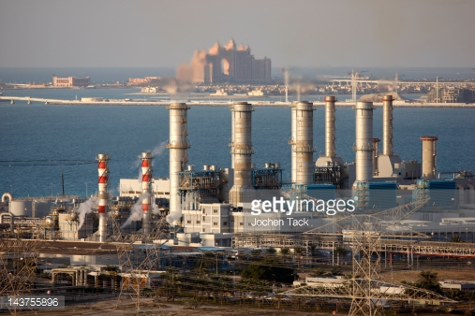
The Natural World - 1
We looked at where our drinking water comes from.
Just 1.2% of Dubai’s water comes from natural ground sources.
Desalination plants convert seawater into 98.8 percent of Dubai’s water supply.

Slide 8
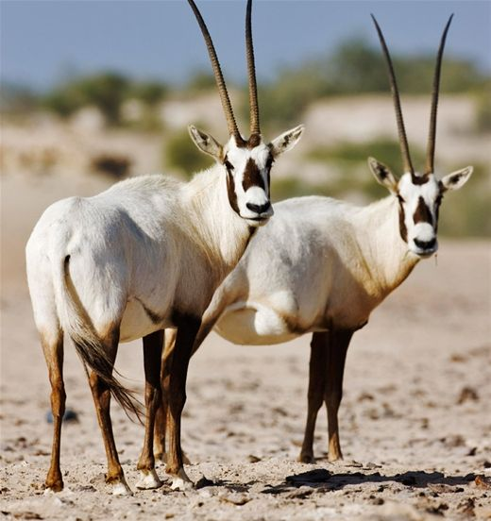
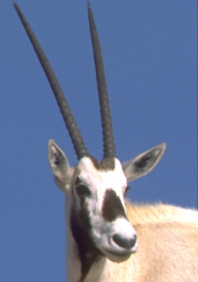
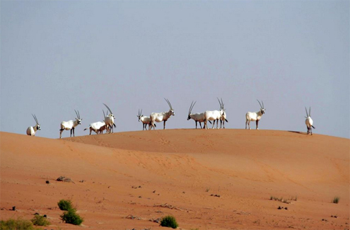
The Natural World - 2
We then looked at the national animal of the UAE – the Arabian Oryx.
There are many reasons this animal now survives in the desert.
For example, we researched that the white body colour helps to deflect the sunlight.
The skin below the hair however is dark and acts as a barrier against ultra-violet rays from the sun so they do not get sunburnt!

Slide 9
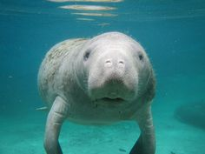
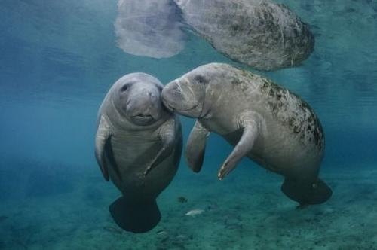
The Natural World - 3
Next there was a UAE creature in the seas.
Dugongs are large marine mammals that are found in tropical and near-tropical seas around the world.
The Gulf hosts an estimated population of 5,000 dugongs, the second largest in the world next to Australia.

Slide 10
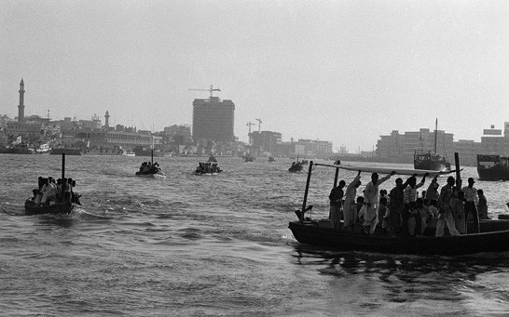
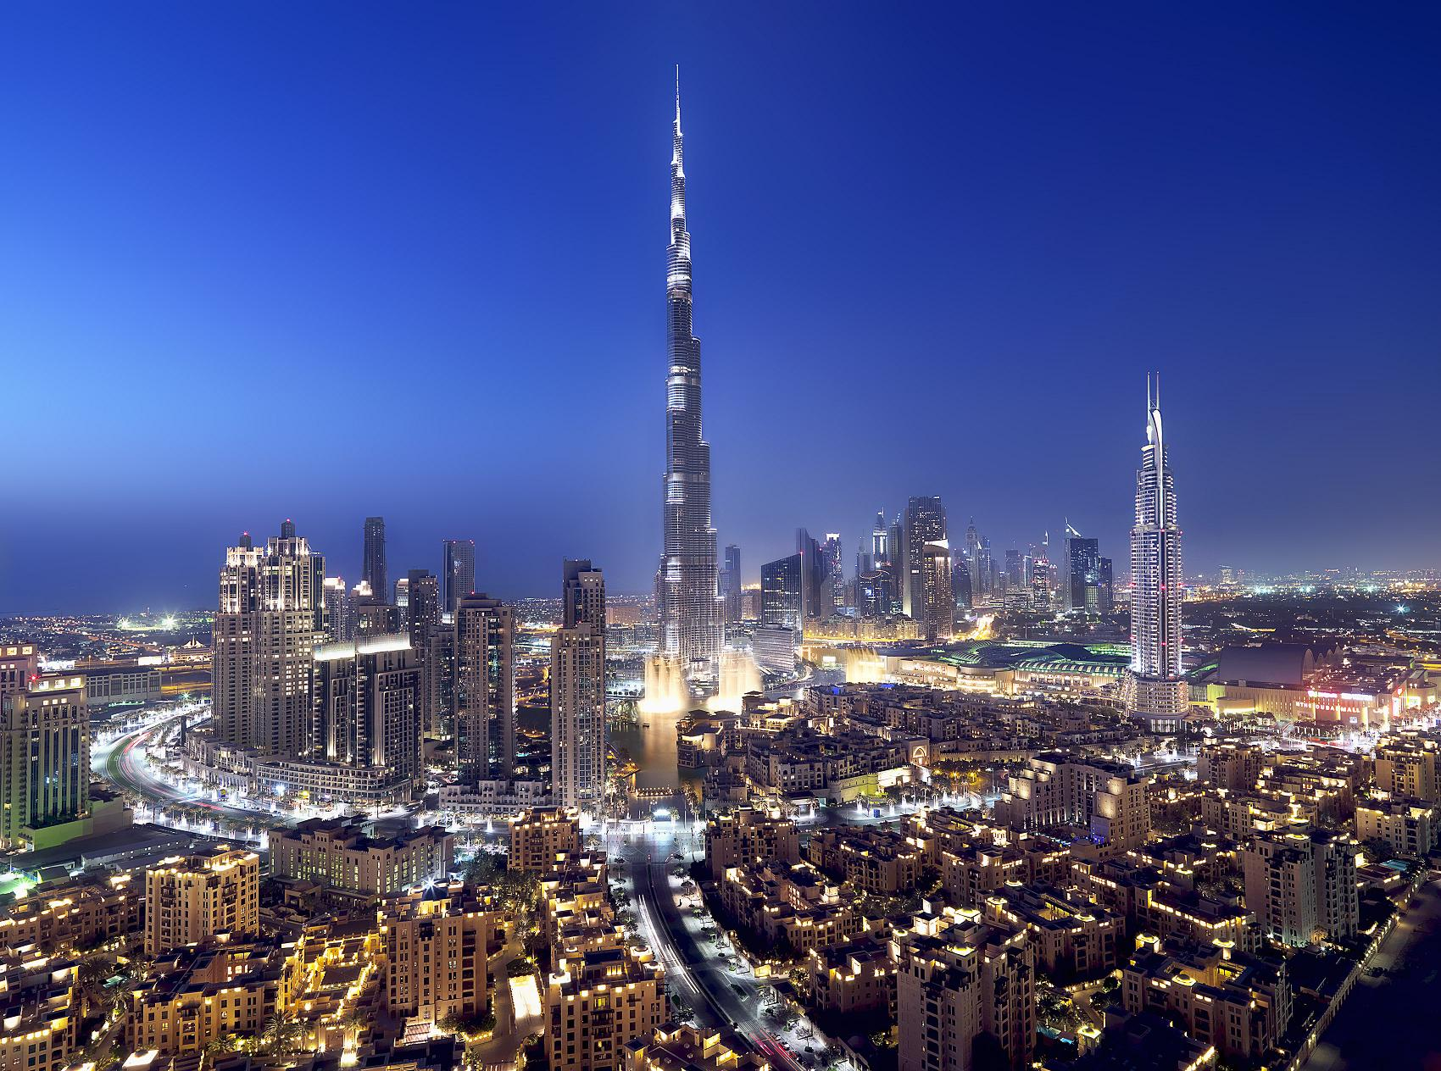
UAE Timelines
Even though the UAE is a young country, there are still many important dates and events to recognize.
The UAE was born
Oil discovered in Abu Dhabi
Pearl diving is big business
Oil discovered in Dubai
When was…
Use The Key to Dubai book to help if necessary.

Slide 11
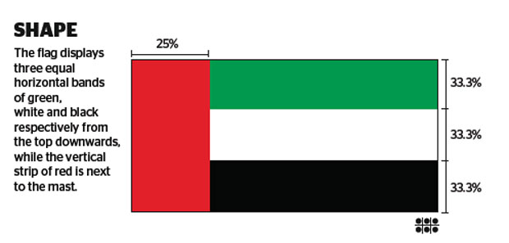
Celebrations and Holidays
We looked at the flag of the UAE and discussed the importance of the flag and its colours.
Green refers to goodness and agriculture, abundant throughout the country. White refers to peace. Black refers to courage and power. Red refers to power and sovereignty.

Slide 12
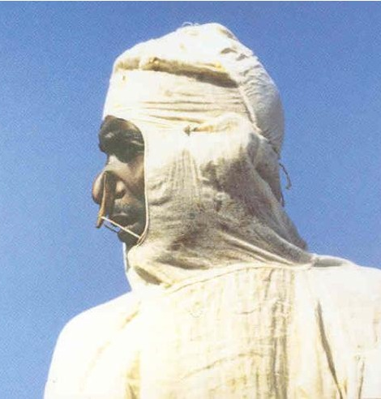
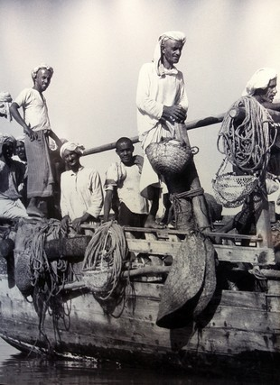
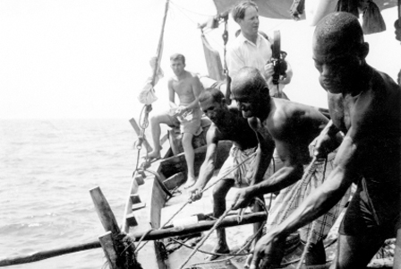
Traditions and Values
One of the earliest industries from the Emirates started from the sea.
The pearl industry was internationally recognized and many companies from around the world wanted pearls from the Emirates.
Although the pearling industry offered potential wealth, it was also very dangerous for the divers, both physically and financially.

Slide 13
Get ready!
Next week we will have a fun quiz.

