Slide 1
Traditional Sports in the UAE
Part 2 – Ancient Hunting Companions

Slide 2
The Saluki

Slide 3
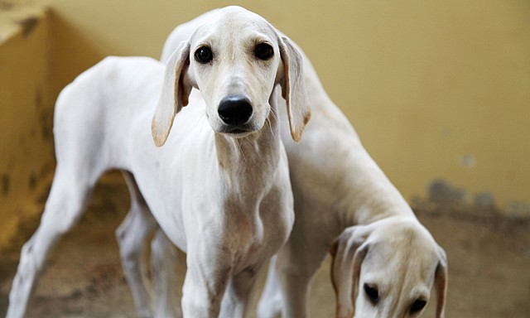
Arabian Salukis are one of the oldest breeds of domesticated dogs in the world and are known for their excellent speed. Intelligence, stamina and loyalty to their owner.

Slide 4
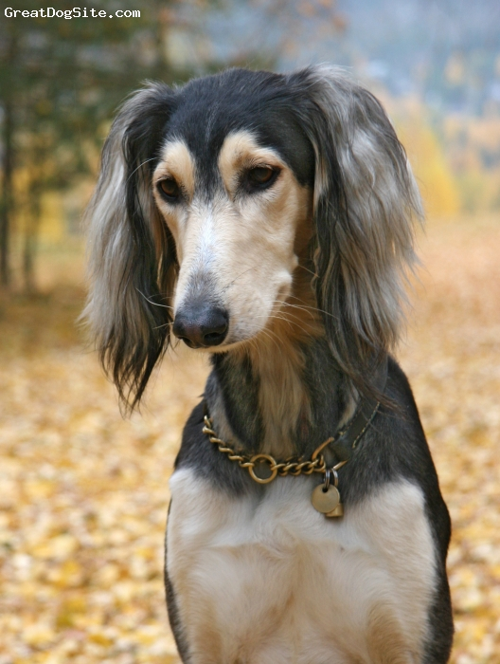
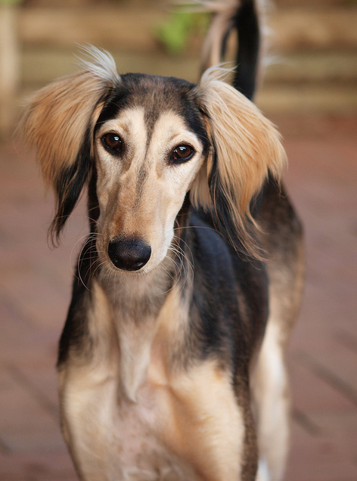
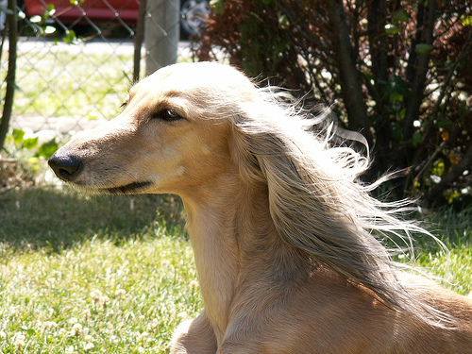
The Bedouin culture has many fascinating stories, crafts and traditions, but perhaps it is their relationship with animals that captures the imagination most.
Horses, camels and falcons have been crucial to survival in the harsh desert environment, but the role in Bedouin life of this particular breed of dog should not be underestimated.

Slide 5
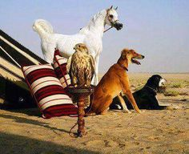
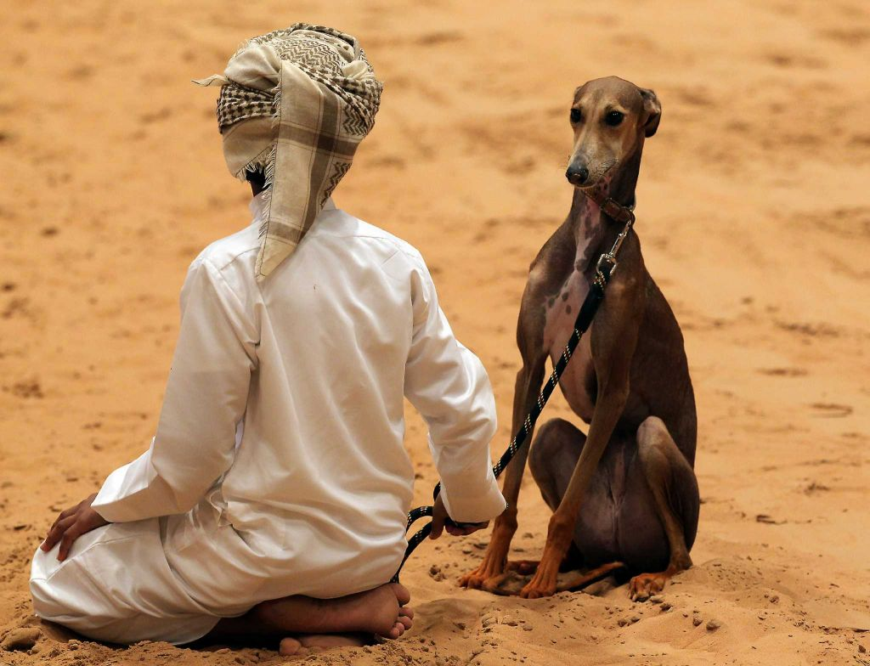

Slide 6
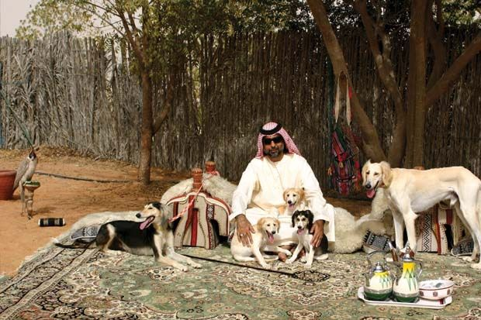
The breed is said to originate from China but the Saluki is named after the Bani Saluk tribe from Yemen.
Like the falcon, the saluki hunts by sight rather than smell. Salukis were used with the falcon by the Bedouin – the falcon would hover over the prey and then the trained saluki would run and catch the prey and bring it back.

Slide 7
There are two types of salukis – smooth hounds called Al Hess and ones with a more feathery coat called Al Reesh.
They start their training when they are about one year old and then start hunting when they are about four years old.
They can run at a top speed of 70 km/h!

Slide 8
The following link leads you to a short introduction to the Arabian Saluki Centre which is in Abu Dhabi. It shows you how much this breed is valued in the UAE.
www.bbc.co.uk/news/world-middle-east-10832444

Slide 9
Optional Extension Activities
Discussion Points
What are some traditional sports in your country?
Are these sports still taking place today? Why/why not?
Are there any of the traditional Emirati sports you would like to do?
Do you think any of them should not be considered a sport? Why?
What do you think is the most popular sport in a) your country, b) the UAE?

Slide 10
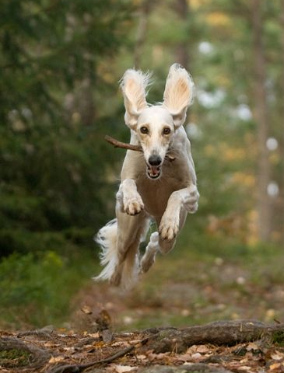
Mini Quiz
How much can you remember?
What is the top speed of a Saluki?
Where did the breed originally come from?
What were they named after?
Why were they so important to the Bedouin tribes?
Why did the Bedouin like to use this particular breed of dog?

