Slide 1
Half-term challenge:
Can you learn the Arabic phrases Mr. Dowlman uses to answer the questions?
Year 1 & 2
If you can prove to your class teacher that you can answer 3 out of 5 of these questions in Arabic, then your name will be put into a prize draw, with prizes being awarded during assembly on Thursday 27th February.
Year 3 - 6
If you can prove to your class teacher that you can answer using ALL 5 questions in Arabic then you will earn 2 Fareek Al Arabee stickers for your class sticker chart.
Mr. Alex will be announcing the winning class and prize during assembly on Thursday 27th February.

Slide 2
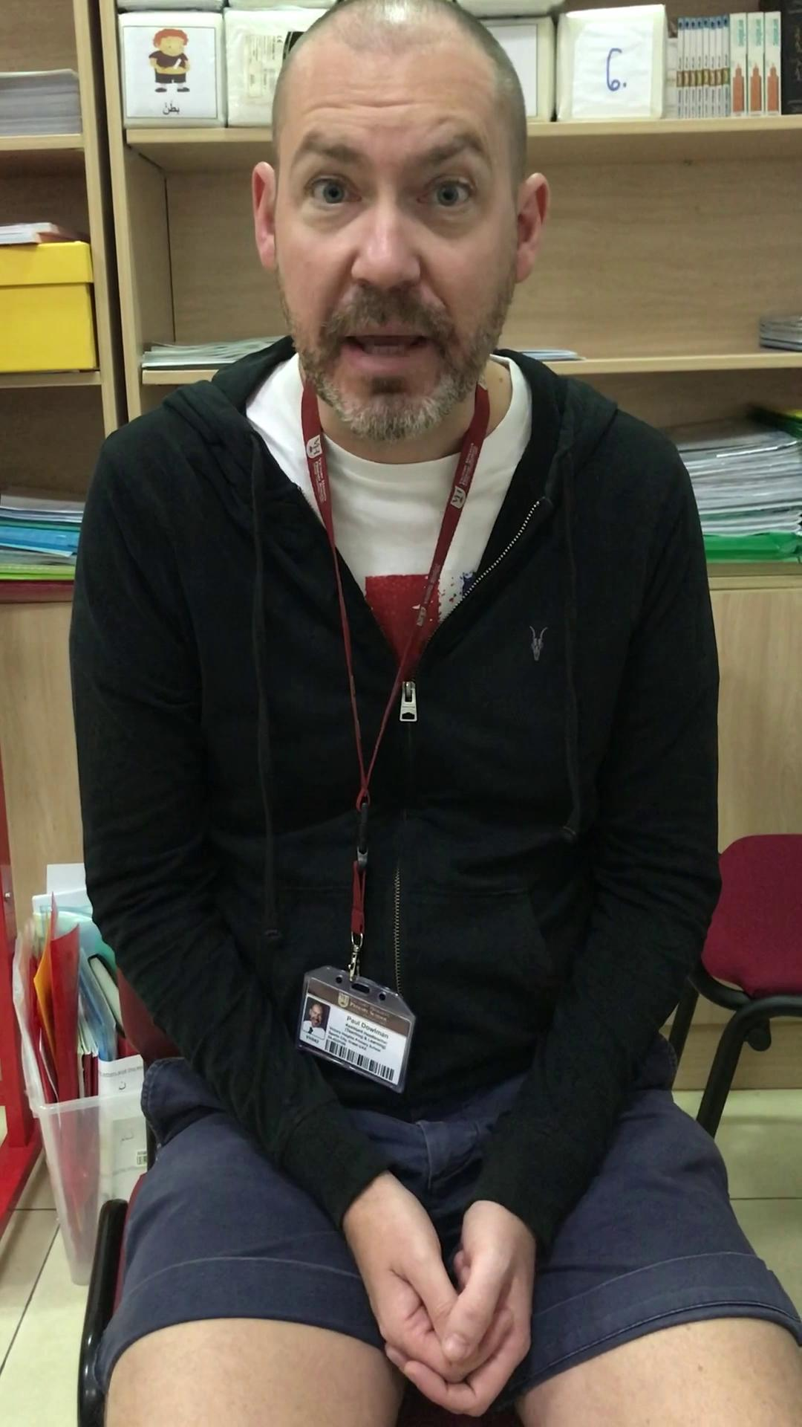
Question: What is your name?
Answer: My name is Paul.

Slide 3
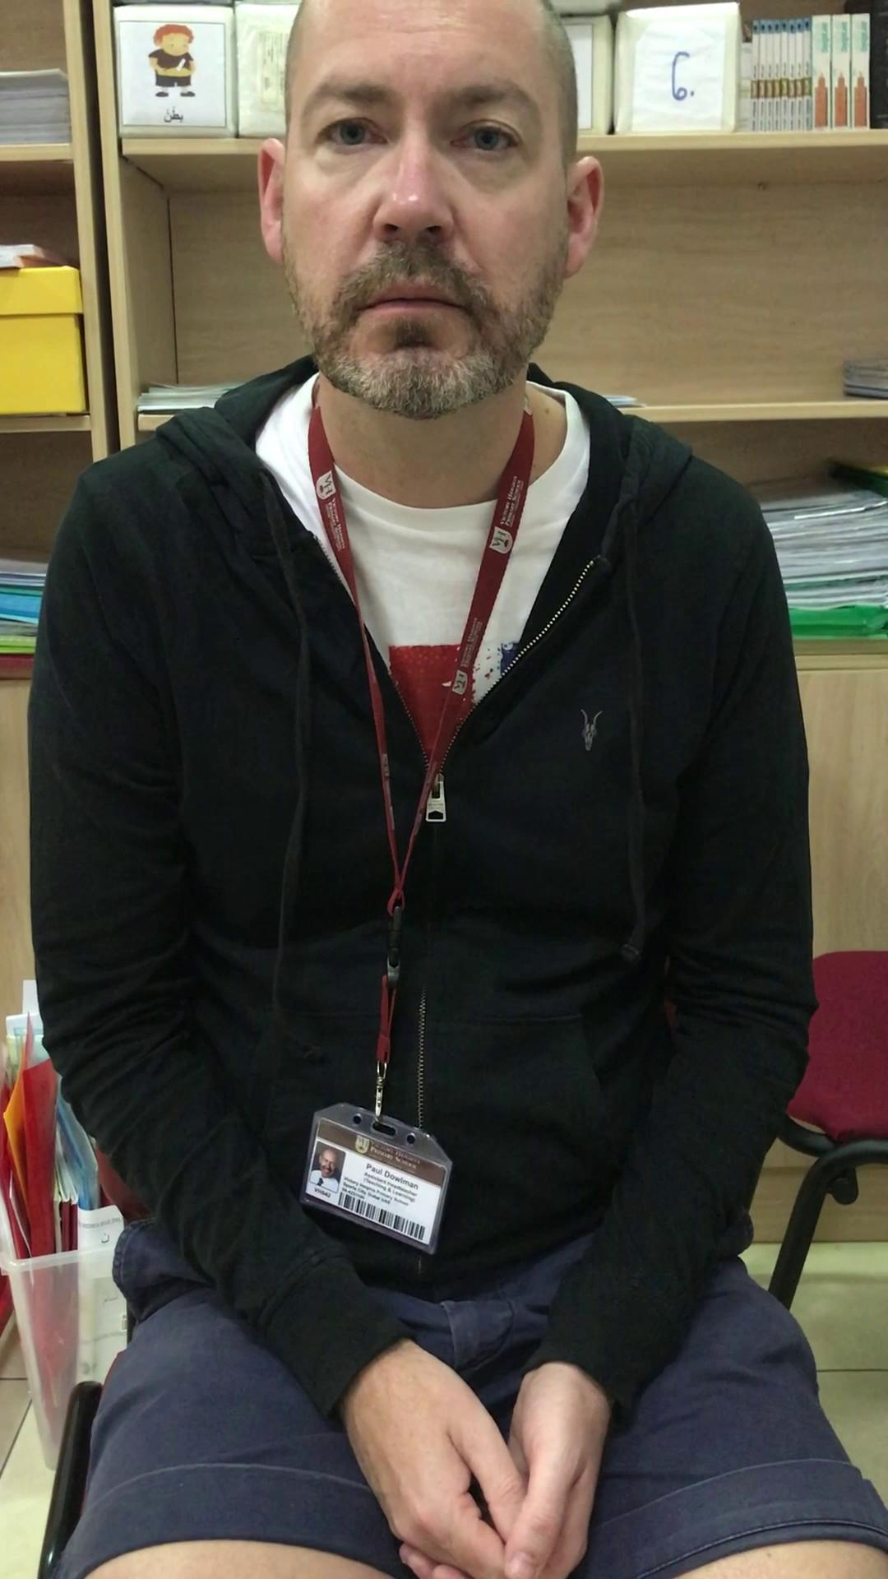
Question: How old are you?
Answer: I am 47.

Slide 4
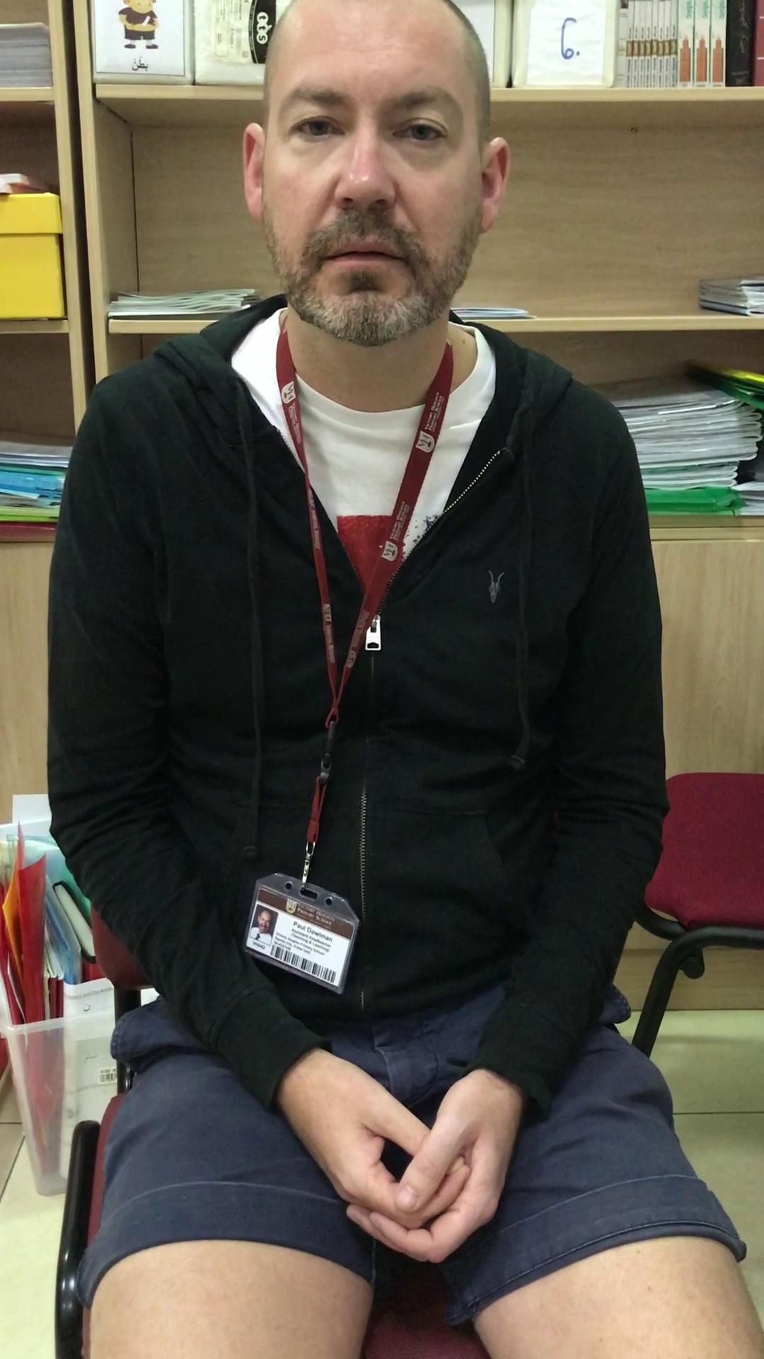
Question: Where are you from?
Answer: I am from England.

Slide 5
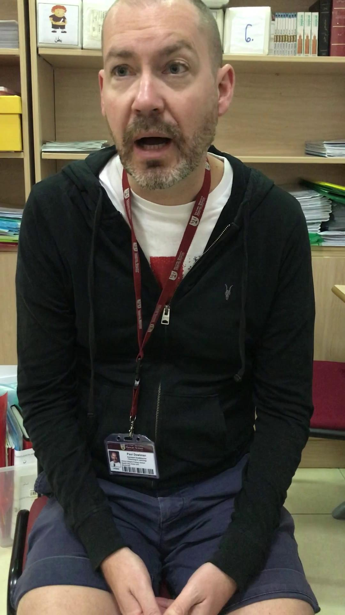
Question: What are you learning?
Answer: I am learning jobs and colours.

Slide 6
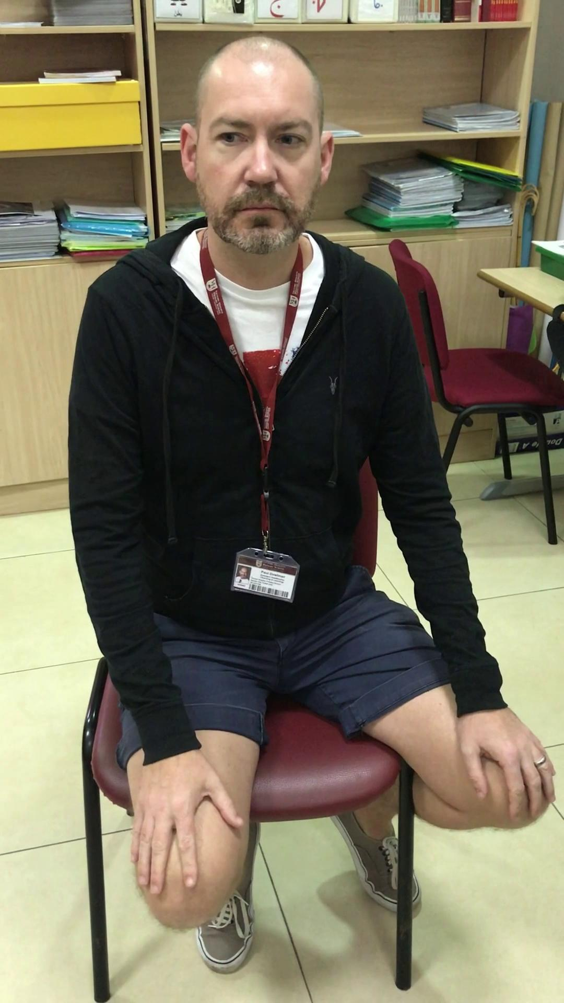
Question: Do you like Arabic?
Answer: Oh yes, I love Arabic.

